Slide 1
Capstone Project
Hotel Booking Analysis

Slide 2
Table of Content
Analysis Based on :
Hotel Type
Cancellation status
Special Requests
Booking ratio (Month/Year)
Country wise comparison
Night stay duration
Most Booked Accommodation
Challenges :
Conclusion :

Slide 3
Problem Statement Analysis Based on following question -
How Many Booking Were Cancelled?
What is the booking ratio between Resort Hotel and City Hotel?
What is the percentage of booking for each year?
Which is the busiest month for hotels?
From which country most guests come?
How Long People Stay in the hotel?
Which was the most booked accommodation type (Single, Couple, Family)?

Slide 4
Data Summary
Data Set Name -- Hotel Booking Database including booking information for a city hotel and a
resort hotel of various countries from 2015 to 2017
Shape --
Row -119390
Column – 32
Important Column -- is_canceled, total_of_special_requests, hotel,arrival_date_year
arrival_date_month,country,stays_in_weekend_nights,stays_in_week_nights,single,couple,
family

Slide 5
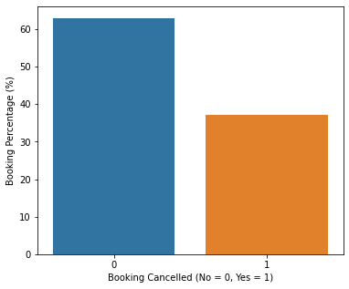
Analysis Based on- How many booking were get canceled

Slide 6
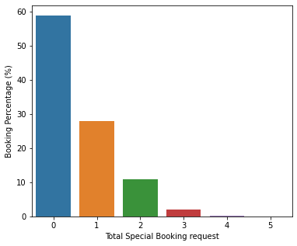
Analysis Based on- Total Special booking Request were made

Slide 7
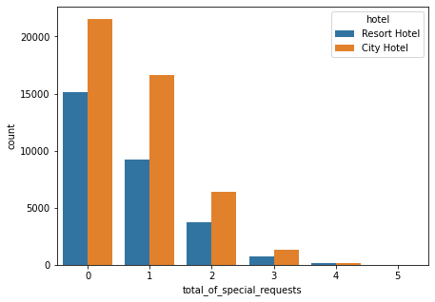

Analysis Based on- Total Special booking Request Hotel wise Comparison

Slide 8
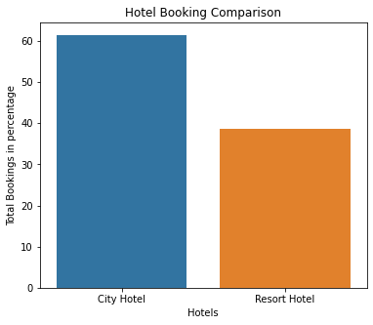
Analysis Based on- What is the booking ratio between Resort Hotel and City Hotel

Slide 9
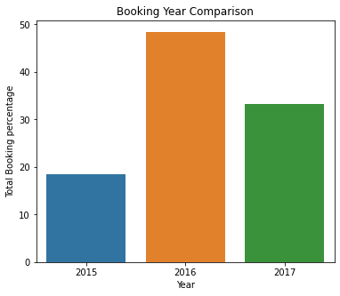
Analysis Based on- Percentage of booking for each year

Slide 10
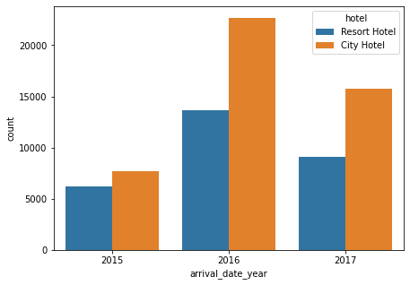
Analysis Based on- Count of booking for each year Hotel wise comparison?

Slide 11
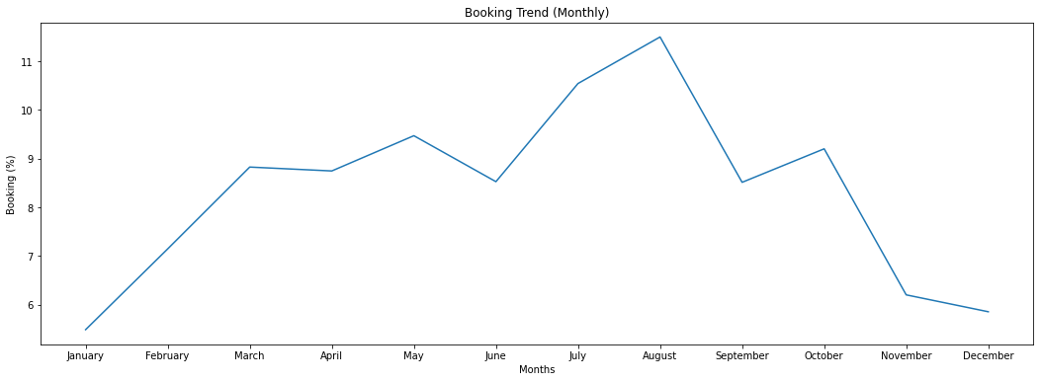
Analysis Based on- Which is the busiest month for hotels?

Slide 12
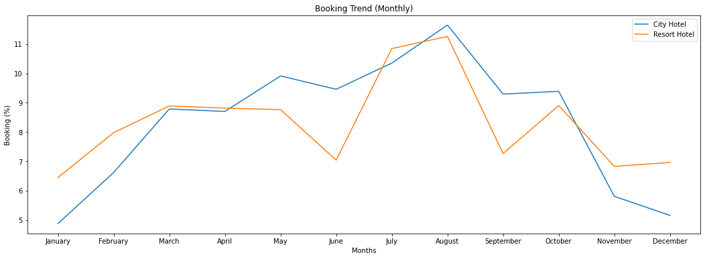
Analysis Based on- Which is the busiest month hotel wise comparison?

Slide 13
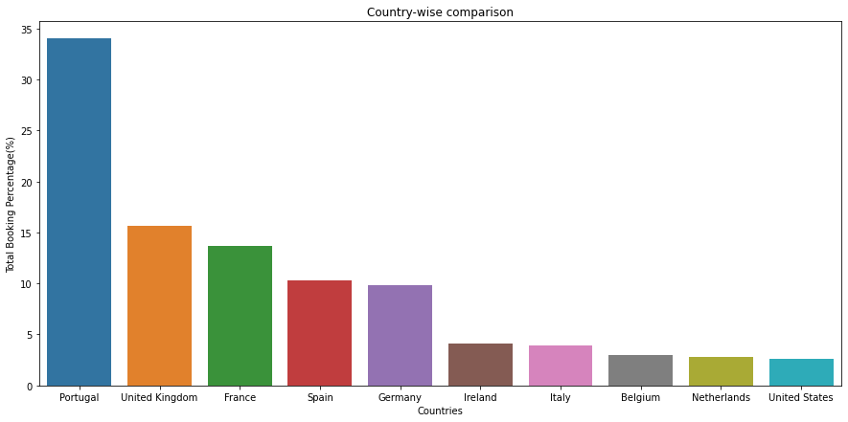
Analysis Based on- From which country most guests come?

Slide 14
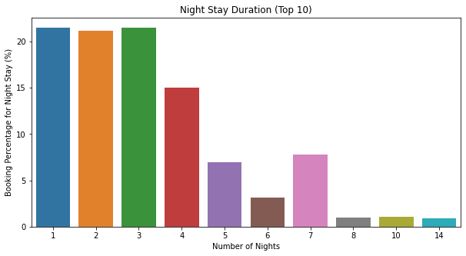
Analysis Based on- How Long People Stay in the hotel?

Slide 15
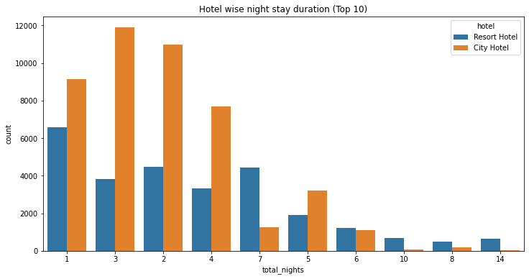
Analysis Based on- For how Long People Stay in Hotel(Hotel wise comparison)

Slide 16
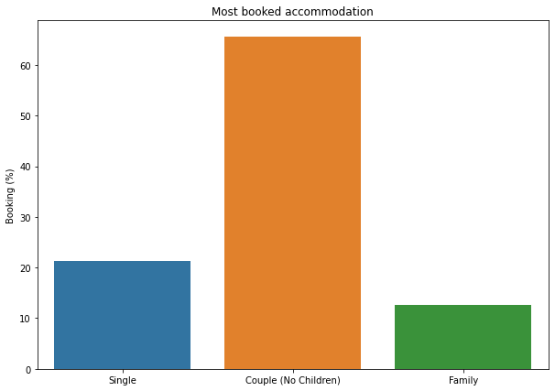
Analysis Based on- Which was the most booked accommodation type (Single, Couple, Family)?

Slide 17
Challenges
Lots of column to work on takes lot of time to identify which column to select to start with.
Lots of NaN values is data set.
Needed to import few Library manually like for country identification.
Data set is containing lots of value it takes time to load

Slide 18
Conclusion
Bookings got canceled 37% of the time. While booking did not get cancelled almost 63% of the time.
There are nearly 59% of 0 Special Request and very less Special requests were made like 1 is 28%, 2 is 10%, 3 is 2% and 4-5 is nearly 0-1%.
Most of the special requests were made for City Hotel only.
More than 60% of the population booked the City hotel.
Highest Booking was done in 2016 is nearly 48%. It was good as compared to the previous year 2015. But at the very next year in 2017 booking ratio was down is at almost 15%.
Highest Booking were done for City hotel only in 2016 nearly 24 thousands.
Most bookings were made from July to August maybe due to summer generally warmer months have more booking than colder month And the least bookings were made at the start and end of the year.
Portugal, the UK, France, Spain and Germany are the top countries from most guests come, more than 80% come from these 5 countries.
Most people stay for one, two, or three. -> For Resort hotel, the most popular stay duration is three, two, one, and four days respectively. -> For City hotel, most popular stay duration is one, two, seven(week), and three respectively
Couple (or 2 adults) is the most popular accommodation type. So hotels can make arrangement plans accordingly

Slide 19
Q & A

